Slide 1
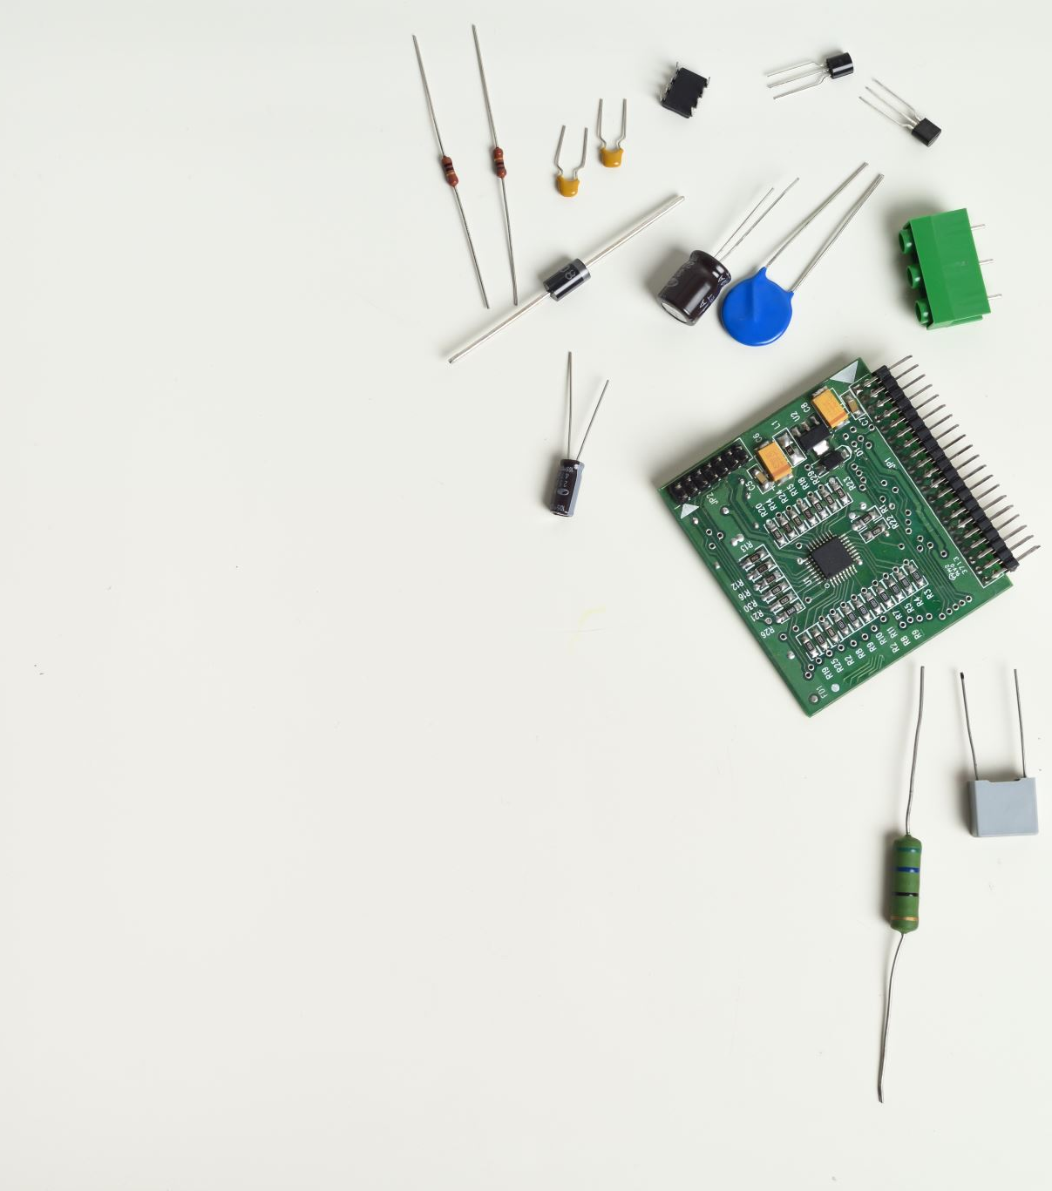

ENGI 301 Project #2 – Guitar Tuner PCB
Callum Parks

Slide 2
Board Functionality
This PCB is based on a previously constructed breadboard implementation of a PocketBeagle based guitar tuning device. This device will play a selected guitar note, and using two buttons, allow a user to turn a servo (interfaced with tuner) to adjust the guitar to match a played frequency.

Slide 3
Functional Block Diagram
screen
Potentimeter
360 Servo
Display
Potentiometer
Output 0-4096
Buzzer
Button
Pocketbeagle
P2_1
P2_9-13
State of Button A
(binary)
P2_2
Button
Gpio 19
P2_4
Servo Clockwise
Buzzer
State of Button B
(Binary)
Servo CClockwise
P2_3
Micro USB power

Slide 4
Mechanical Block diagram with approximate measurements
Buttons A and B (10x10mm)
PocketBeagle
(56x35mm
Potentiometer
Buzzer
67mm
SCREEN
28x58mm
Servo output
88mm

